Slide 1

UNIVERSITY INSTITUTE OF ENGINEERING
COMPUTER SCIENCE ENGINEERING
Bachelor of Engineering (Computer Science & Engineering)
Subject Name: Big Data Analytics
Subject Code: 20CST-471
Walmart utilization
Mapped with CO5
Prepared By:
Er. Ankita Sharma
DISCOVER . LEARN . EMPOWER

Slide 2
Walmart utilization
Walmart is a global retail giant that has extensively utilized big data to enhance various aspects of its operations, improve customer experience, and optimize business processes. Here's an overview of how Walmart leverages big data:
1. Inventory Management and Supply Chain Optimization:
Walmart employs big data analytics to optimize inventory levels and streamline supply chain operations. Through the analysis of historical sales data, real-time inventory tracking, and demand forecasting, Walmart ensures that its shelves are well-stocked with the right products.

Slide 3
2. Demand Forecasting and Predictive Analytics:
By analyzing vast amounts of transactional and historical data, Walmart can make accurate predictions about customer demand for different products. This enables the company to optimize inventory, reduce overstocking or stockouts, and minimize holding costs.
3. Price Optimization:
Walmart uses big data analytics to dynamically adjust pricing strategies based on various factors, including competitor pricing, customer behavior, and market trends. This helps Walmart remain competitive and offer value to its customers.

Slide 4
4. Customer Analytics and Personalization:
Walmart collects and analyzes customer data to understand shopping patterns, preferences, and behaviors. This information is used to personalize marketing efforts, recommend products to customers, and enhance the overall shopping experience both online and in-store.
5. Operational Efficiency and Cost Reduction:
Big data analytics allows Walmart to optimize its operations and reduce costs. For instance, the company uses data to optimize the routes of its delivery trucks, minimize fuel consumption, and improve overall logistics efficiency.

Slide 5
6. E-commerce and Online Shopping Experience:
Walmart's big data initiatives extend to its online platform. The company uses data analytics to improve the online shopping experience, recommend products to online shoppers, and personalize the website for individual users.
7. Social Media Analytics:
Walmart monitors social media platforms to gain insights into customer sentiment, feedback, and preferences. This information is valuable for understanding trends, managing brand reputation, and addressing customer concerns in a timely manner.

Slide 6
8. Energy Efficiency and Sustainability:
Walmart utilizes big data to enhance energy efficiency in its stores. The analysis of data related to lighting, heating, and cooling systems helps Walmart reduce energy consumption and minimize its environmental impact.
9. Fraud Detection and Security:
Big data analytics is employed to detect fraudulent activities, such as unauthorized transactions or security breaches. Walmart uses advanced analytics and machine learning algorithms to identify irregular patterns and enhance the security of its financial transactions.

Slide 7
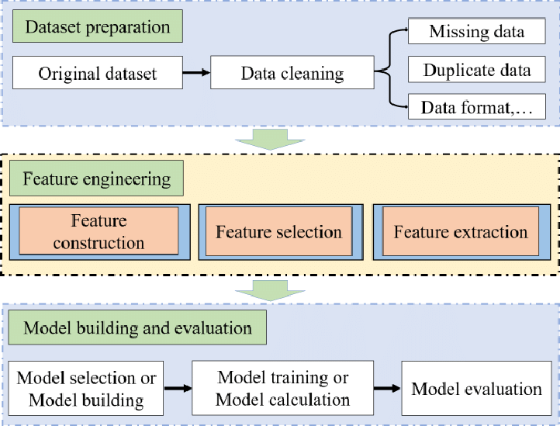

Slide 8
Thankyou

